Slide 1
Deep Learning
2. Convolutional Neural Networks
Term 4, 2025
Skoltech

Slide 2
Outline of the lecture
Introduction
Biological inspiration
Foundations in classical computer vision
Why convolutions work for images
Mathematical definition
Early beginnings of CNNs
The CNN winter and revival
The deep learning revolution

Slide 3
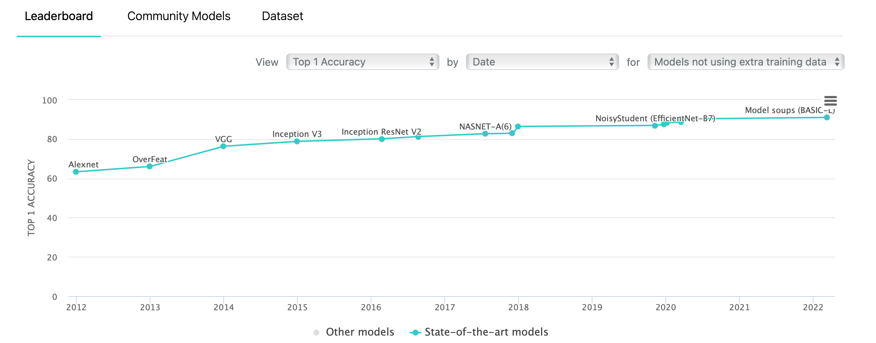
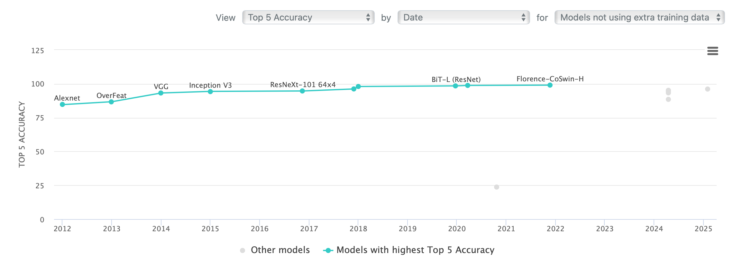
Introduction
CNNs revolutionized computer vision:
They became the dominant approach for image recognition tasks since 2012
They achieved superhuman performance on many visual tasks
Very high ImageNet classification accuracy
https://paperswithcode.com/sota/image-classification-on-imagenet

Slide 4
Introduction
Inspired by the visual cortex of animals
The hierarchical structure of CNNs mirrors the organization of the mammalian visual system
Early layers detect simple features like edges and textures, while deeper layers recognize complex patterns
Hubel and Wiesel's Nobel Prize-winning work on the visual cortex provided the biological foundation
https://pmc.ncbi.nlm.nih.gov/articles/PMC1359523/
https://www.nobelprize.org/prizes/medicine/1981/press-release/

Slide 5
Introduction
CNNs are designed to process grid-like data (images)
Unlike fully connected networks, CNNs preserve spatial relationships in data
CNNs can efficiently process high-dimensional visual data with fewer parameters
Mathematical properties of convolutions make them particularly suitable for image processing
https://arxiv.org/abs/1803.01164

Slide 6
Introduction
Bridge between classical signal processing and modern deep learning
CNNs incorporate principles from traditional signal processing (filtering, downsampling)
CNNs automate the feature engineering process that was previously done manually
Zeiler and Fergus visualized learned features (we will see them later)
https://arxiv.org/abs/1311.2901

Slide 7
Biological Inspiration
Hubel and Wiesel's experiments (1959-1962)
David Hubel and Torsten Wiesel recorded neural activity in the cat's visual cortex
They discovered that neurons respond to specific patterns of light in their receptive fields
Their 1962 paper established the foundation for understanding visual processing
https://www.ncbi.nlm.nih.gov/pmc/articles/PMC1359523/
They received the Nobel Prize in Physiology or Medicine in 1981 for this work
https://www.nobelprize.org/prizes/medicine/1981/press-release/

Slide 8
Biological Inspiration
Discovery of simple and complex cells in visual cortex
Simple cells respond to oriented edges at specific positions
Complex cells respond to oriented edges regardless of position
This hierarchical organization inspired the design of CNNs
Fukushima's Neocognitron (1980) was the first model to implement this architecture
https://www.cs.princeton.edu/courses/archive/spr08/cos598B/Readings/Fukushima1980.pdf

Slide 9
Biological Inspiration
Cells respond to specific patterns within receptive fields
Each neuron has a limited "view" of the visual field (receptive field)
Neurons at different levels have different receptive field sizes
This property is implemented in CNNs through varying kernel sizes and network depth
Visualization of receptive fields in CNNs shows striking similarities to biological systems
https://distill.pub/2017/feature-visualization
Will be displayed later

Slide 10
Biological Inspiration
Hierarchical processing of visual information
Information flows from simple features to complex patterns
Each layer builds upon the representations from previous layers
This hierarchical structure enables CNNs to learn increasingly abstract features
Zeiler and Fergus's visualization technique (2013) revealed what each layer learns
https://arxiv.org/abs/1311.2901
Will be displayed later

Slide 11
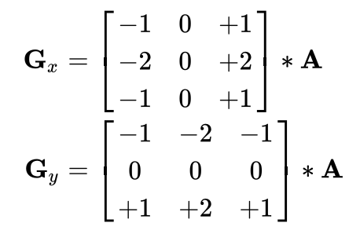
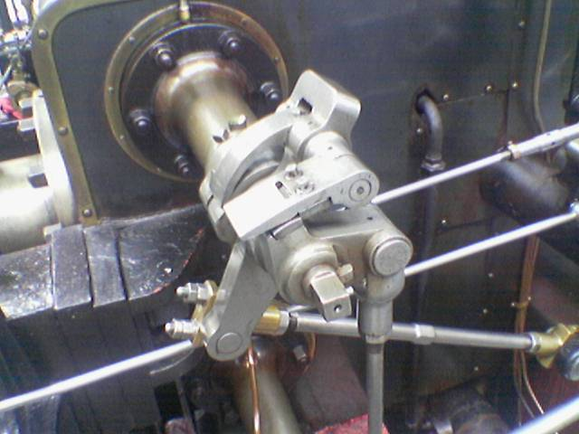
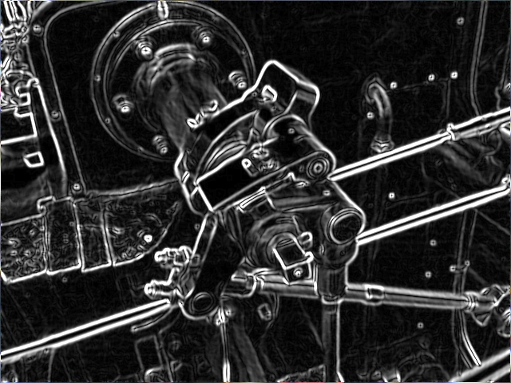
Foundations in Classical Computer Vision
Traditional CV used hand-crafted filters
Edge detection (Sobel)
By Simpsons contributor, CC BY-SA 3.0, https://commons.wikimedia.org/w/index.php?curid=8904364

Slide 12

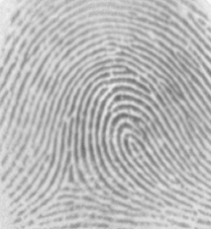
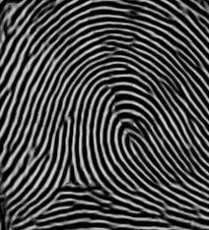
Foundations in Classical Computer Vision
Traditional CV used hand-crafted filters
Gabor filters
By AkanoToE - Own work based on: Gabor filter.png, CC BY-SA 4.0,
https://commons.wikimedia.org/w/index.php?curid=88998601
By MrJacobs – Own work, CC BY-SA 3.0, https://commons.wikimedia.org/w/index.php?curid=23580768

Slide 13

Foundations in Classical Computer Vision
Traditional CV used hand-crafted filters
Sharpening
Sharpening enhances edges by subtracting a blurred version from the original
Example kernel: [[0, -1, 0], [-1, 5, -1], [0, -1, 0]]
https://en.wikipedia.org/wiki/Unsharp_masking
By Nevit Dilmen - Own work, Public Domain, https://commons.wikimedia.org/w/index.php?curid=3884055

Slide 14
Foundations in Classical Computer Vision
Traditional CV used hand-crafted filters
Strong edge detection
Laplacian of Gaussian (LoG) detects edges at multiple scales
Gaussian smoothing + Laplacian (sum of 2nd order derivatives) filters
https://homepages.inf.ed.ac.uk/rbf/HIPR2/log.htm

Slide 15
Why Convolutions Work for Images
Local connectivity
CNNs process small patches of the image at each layer
This reduces the number of parameters compared to fully connected networks
For a 1000×1000 image with a single input channel, a fully connected layer would need 10^12 parameters, while a CNN with 3×3 kernels needs only 9 parameters per filter
The same weights are used for all positions in the image
This enables translation invariance and further reduces parameters
A 3×3 filter with 64 channels has only 3×3×64 = 576 parameters, regardless of image size

Slide 16
Why Convolutions Work for Images
Spatial hierarchy
Deeper layers capture more complex patterns
Early layers detect simple features (edges, textures)
Middle layers detect parts (eyes, wheels)
Deep layers detect objects (faces, cars)
Visualization of hierarchical features
https://distill.pub/2017/feature-visualization/

Slide 17
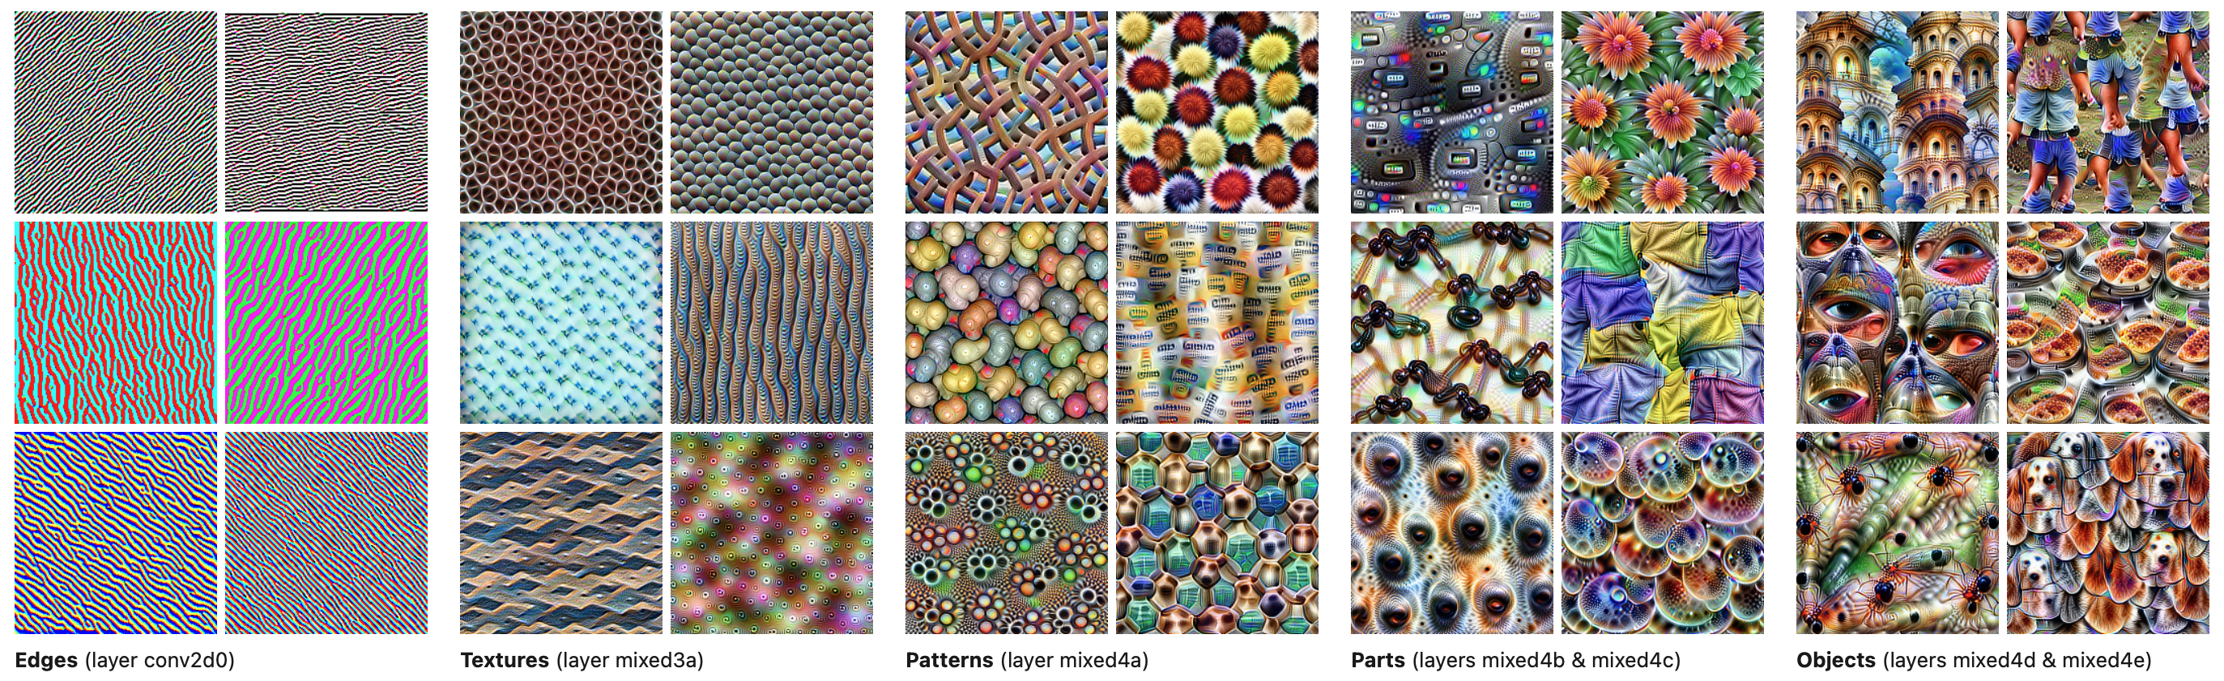
Why Convolutions Work for Images
Spatial hierarchy: Deeper layers capture more complex patterns
Feature visualization allows us to see how GoogLeNet
https://distill.pub/2017/feature-visualization/

Slide 18
Why Convolutions Work for Images
Translation invariance
Detect features regardless of position
CNNs can recognize objects even if they appear in different locations
This is achieved through the combination of convolutions and pooling
Images exhibit locality properties
Nearby pixels are more related than distant ones
This property makes convolutions a natural choice for image processing
It's why CNNs are more efficient than fully connected networks for images

Slide 19
Why Convolutions Work for Images
Cross-correlation vs. Convolution
In practice, CNNs use cross-correlation, not true convolution
In true convolution, the kernel is flipped before applying
CNNs typically use cross-correlation (no flipping)
This is a minor difference that doesn't affect the learning process
Convolution is actually used in the backward propagation phase
https://en.wikipedia.org/wiki/Cross-correlation

Slide 20
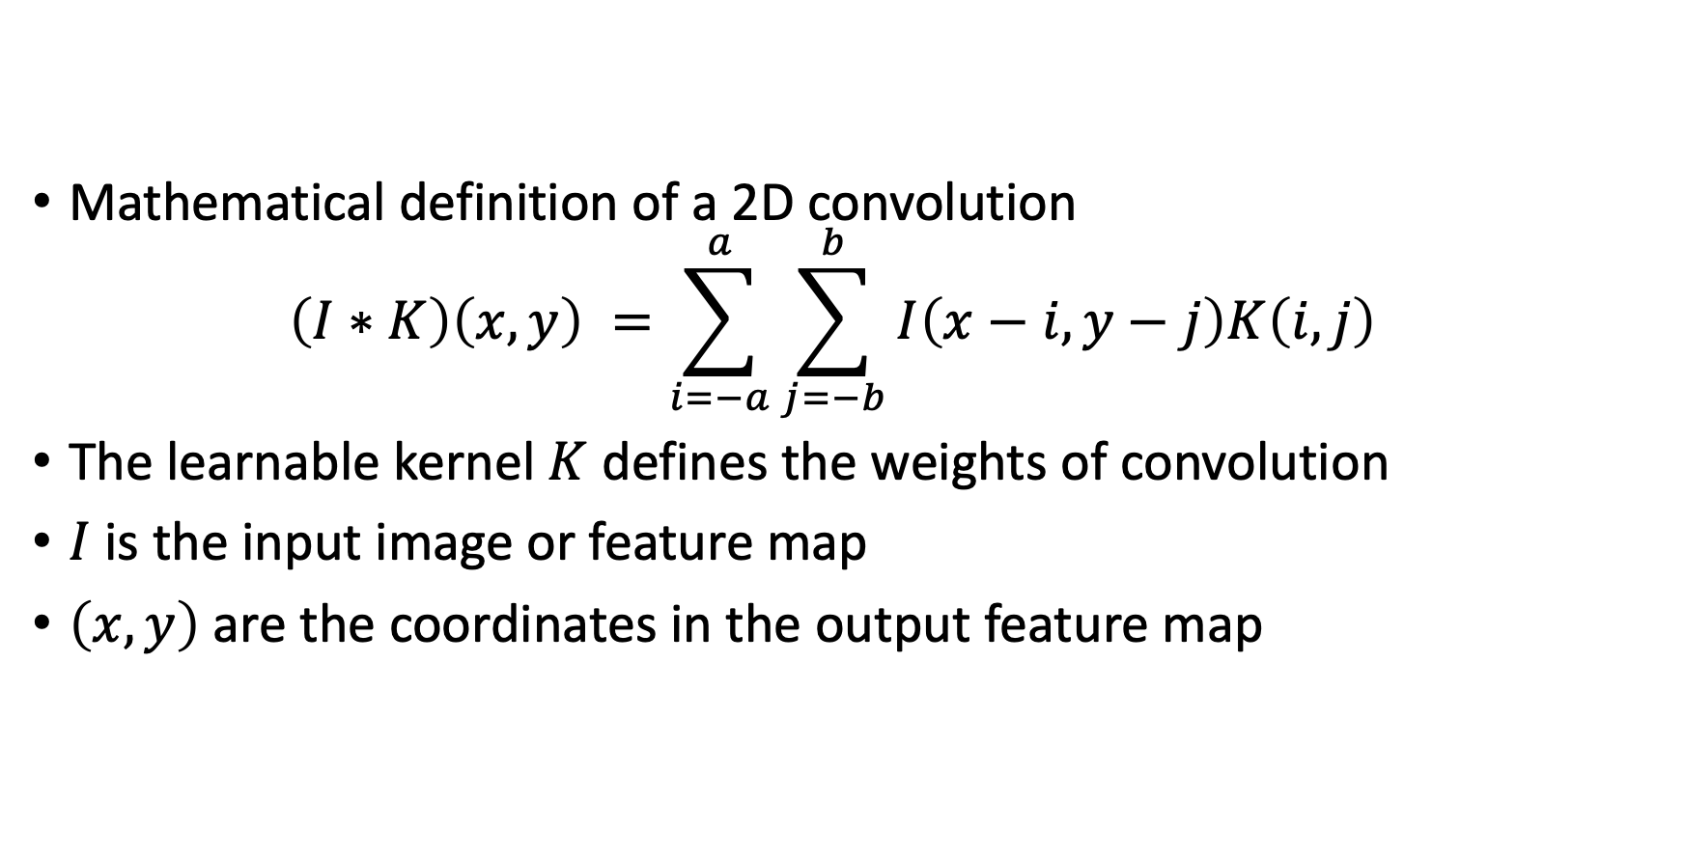
Mathematical Definition
Mathematical definition of a 2D convolution $\left(I∗K\right)\left(x,y\right) =\sum_{i=−a}^{a}{\sum_{j=−b}^{b}{I\left(x−i,y−j\right)K\left(i,j\right)}}$
The learnable kernel $K$ defines the weights of convolution
$I$ is the input image or feature map
$\left(x,y\right)$ are the coordinates in the output feature map

Slide 21
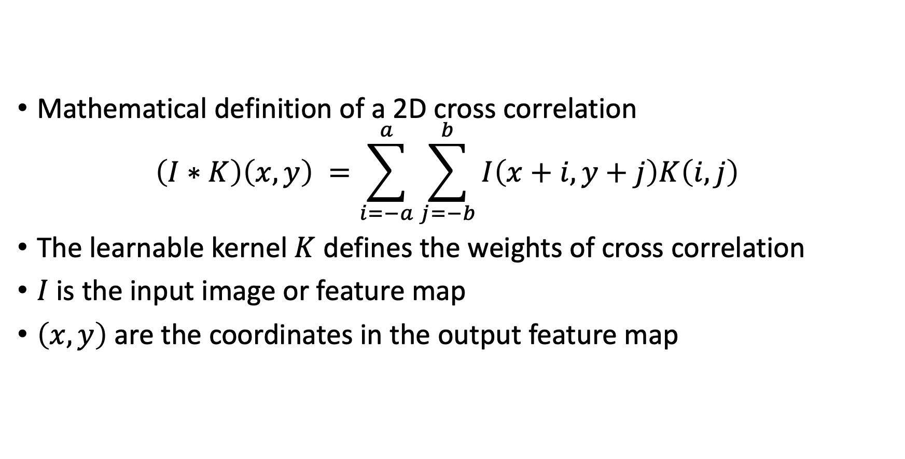
Mathematical Definition
Mathematical definition of a 2D cross correlation $\left(I∗K\right)\left(x,y\right) =\sum_{i=−a}^{a}{\sum_{j=−b}^{b}{I\left(x+i,y+j\right)K\left(i,j\right)}}$
The learnable kernel $K$ defines the weights of cross correlation
$I$ is the input image or feature map
$\left(x,y\right)$ are the coordinates in the output feature map

Slide 22
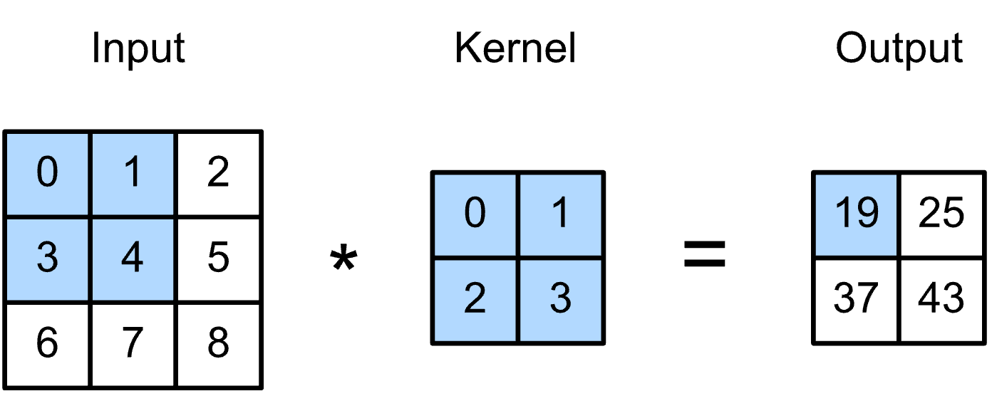
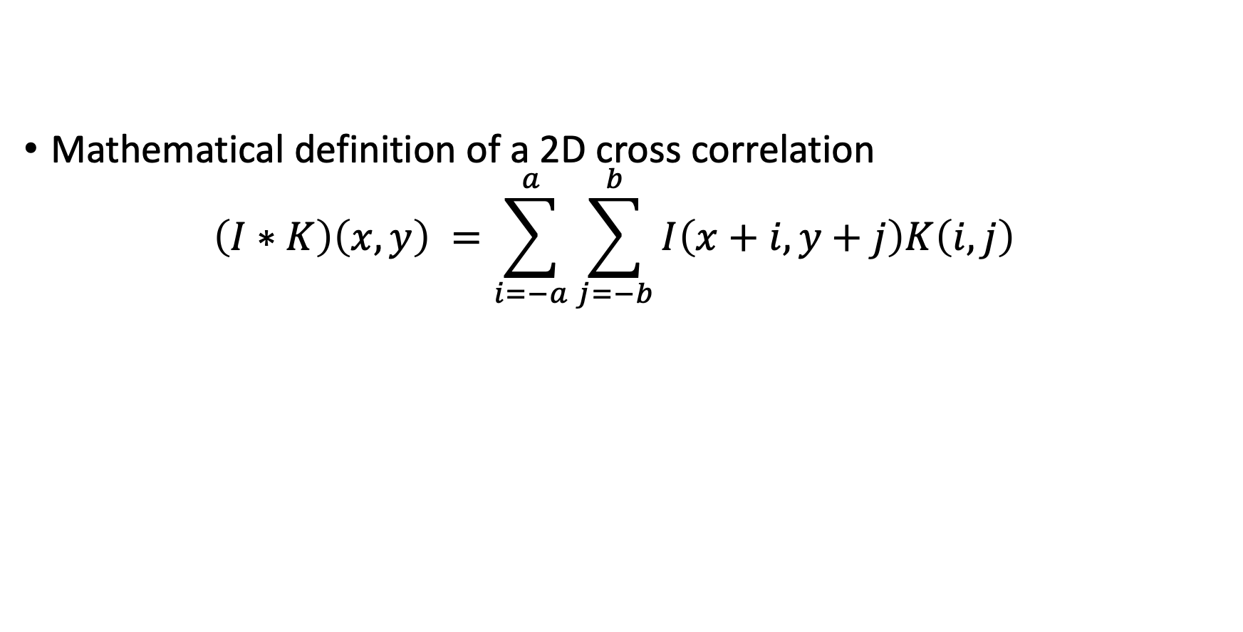
Mathematical Definition
Mathematical definition of a 2D cross correlation $\left(I∗K\right)\left(x,y\right) =\sum_{i=−a}^{a}{\sum_{j=−b}^{b}{I\left(x+i,y+j\right)K\left(i,j\right)}}$
Source: https://raw.githubusercontent.com/oseledets/dl2024/8d739d06892c9cc71f198c1c478d51b4a6801866/lectures/lecture-2/correlation.svg

Slide 23
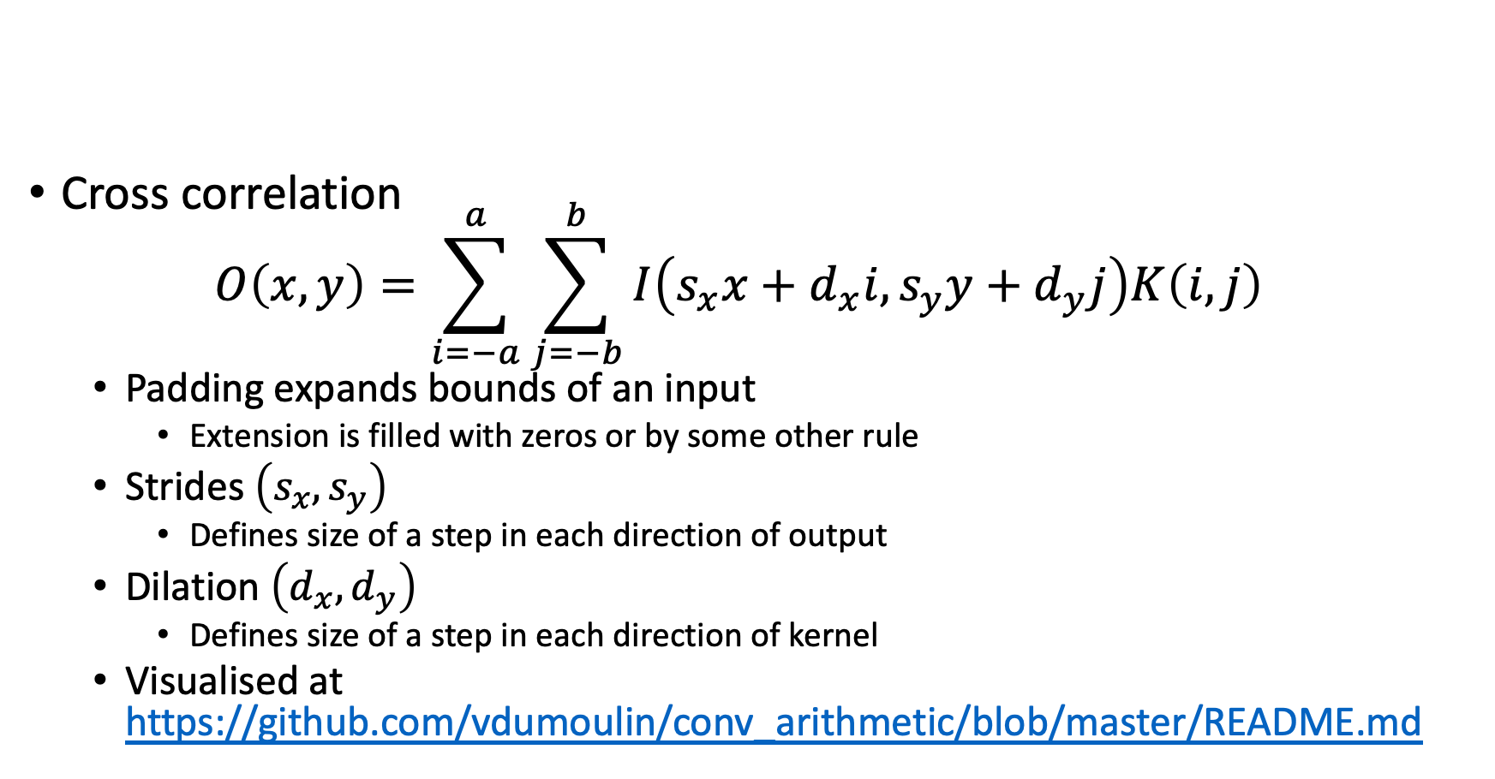
Mathematical definition
Cross correlation $O\left(x,y\right)=\sum_{i=−a}^{a}{\sum_{j=−b}^{b}{I\left(s_{x}x+d_{x}i,s_{y}y+d_{y}j\right)K\left(i, j\right)}}$
Padding expands bounds of an input
Extension is filled with zeros or by some other rule
Strides $\left(s_{x},s_{y}\right)$
Defines size of a step in each direction of output
Dilation $\left(d_{x},d_{y}\right)$
Defines size of a step in each direction of kernel
Visualised at https://github.com/vdumoulin/conv_arithmetic/blob/master/README.md

Slide 24
Data Formats
Shape of a batch of images is described by
N: Batch size (number of images)
C: Number of channels (e.g., 3 for RGB)
H: Height of the image
W: Width of the image
Batches are stored in one of the standard row-major formats
NHWC: better for CPUs and Tensor-core GPUs, default for Tensorflow
NCHW: better for non-Tensor-core GPUs, default for Pytorch
https://forums.developer.nvidia.com/t/nhwc-vs-nchw-convolution/111065

Slide 25
NCHW Data Format
NCHW Format (2 images, 3 channels, 2x4 pixels):
┌─────────────────────────────────────────────────────────┐
│ Image 1 ┌─────────────┐ ┌─────────────┐ ┌─────────────┐│
│ │ R Channel │ │ G Channel │ │ B Channel ││
│ │ 1 2 3 4 │ │ 9 10 11 12 │ │ 17 18 19 20 ││
│ │ 5 6 7 8 │ │ 13 14 15 16 │ │ 21 22 23 24 ││
│ └─────────────┘ └─────────────┘ └─────────────┘│
│ Image 2 ┌─────────────┐ ┌─────────────┐ ┌─────────────┐│
│ │ R Channel │ │ G Channel │ │ B Channel ││
│ │ 25 26 27 28 │ │ 33 34 35 36 │ │ 41 42 43 44 ││
│ │ 29 30 31 32 │ │ 37 38 39 40 │ │ 45 46 47 48 ││
│ └─────────────┘ └─────────────┘ └─────────────┘│
└─────────────────────────────────────────────────────────┘

Slide 26
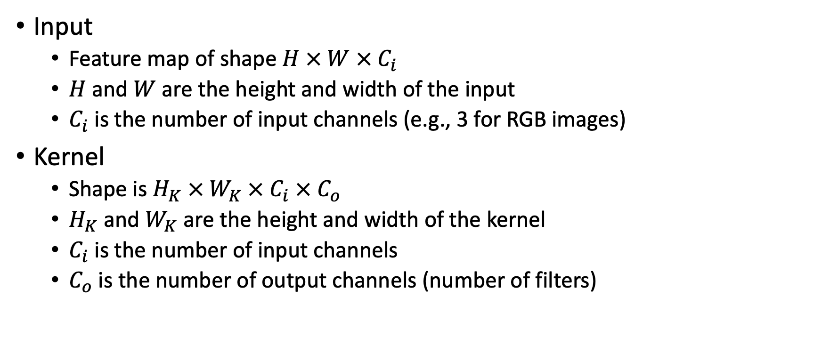
Forward pass of a Convolutional Layer
Input
Feature map of shape $H × W × C_{i}$
$H$ and $W$ are the height and width of the input
$C_{i}$ is the number of input channels (e.g., 3 for RGB images)
Kernel
Shape is $H_{K} × W_{K} × C_{i} × C_{o}$
$H_{K}$ and $W_{K}$ are the height and width of the kernel
$C_{i}$ is the number of input channels
$C_{o}$ is the number of output channels (number of filters)

Slide 27
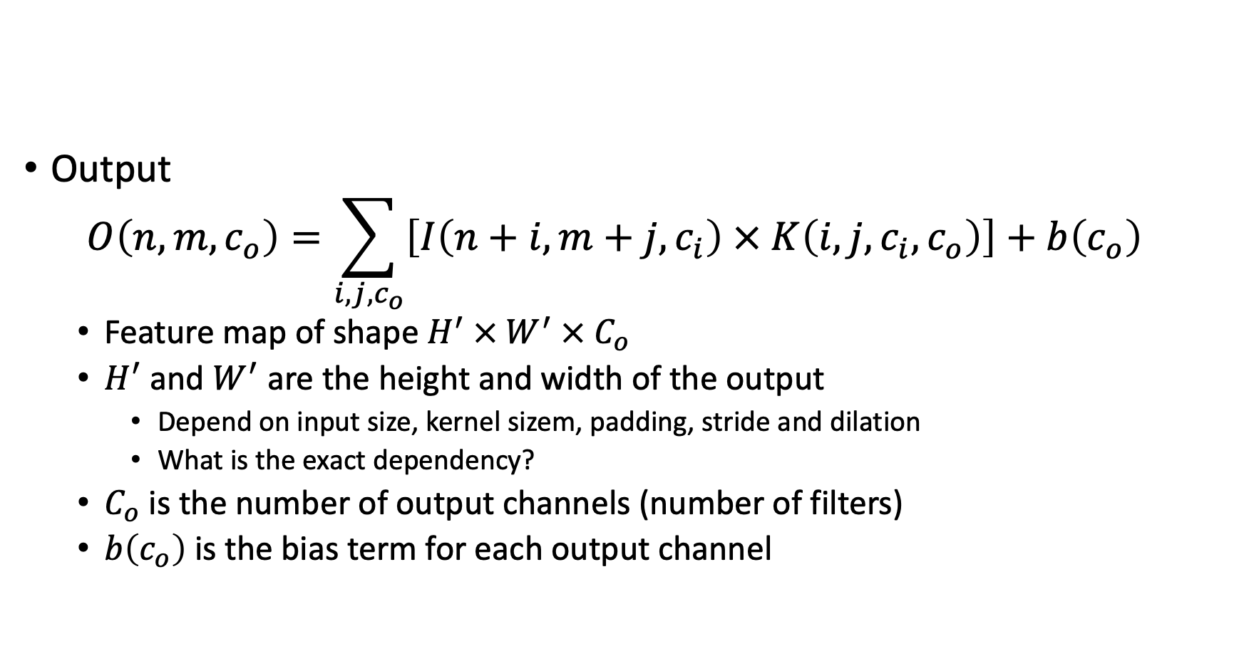
Forward pass of a Convolutional Layer
Output $O\left(n,m,c_{o}\right)=\sum_{i,j,c_{o}}{\left[I\left(n+i,m+j,c_{i}\right) × K\left(i, j, c_{i},c_{o}\right)\right]}+b\left(c_{o}\right)$
Feature map of shape $H^{′} × W^{′} × C_{o}$
$H^{′}$ and $W^{′}$ are the height and width of the output
Depend on input size, kernel sizem, padding, stride and dilation
What is the exact dependency?
$C_{o}$ is the number of output channels (number of filters)
$b\left(c_{o}\right)$ is the bias term for each output channel

Slide 28
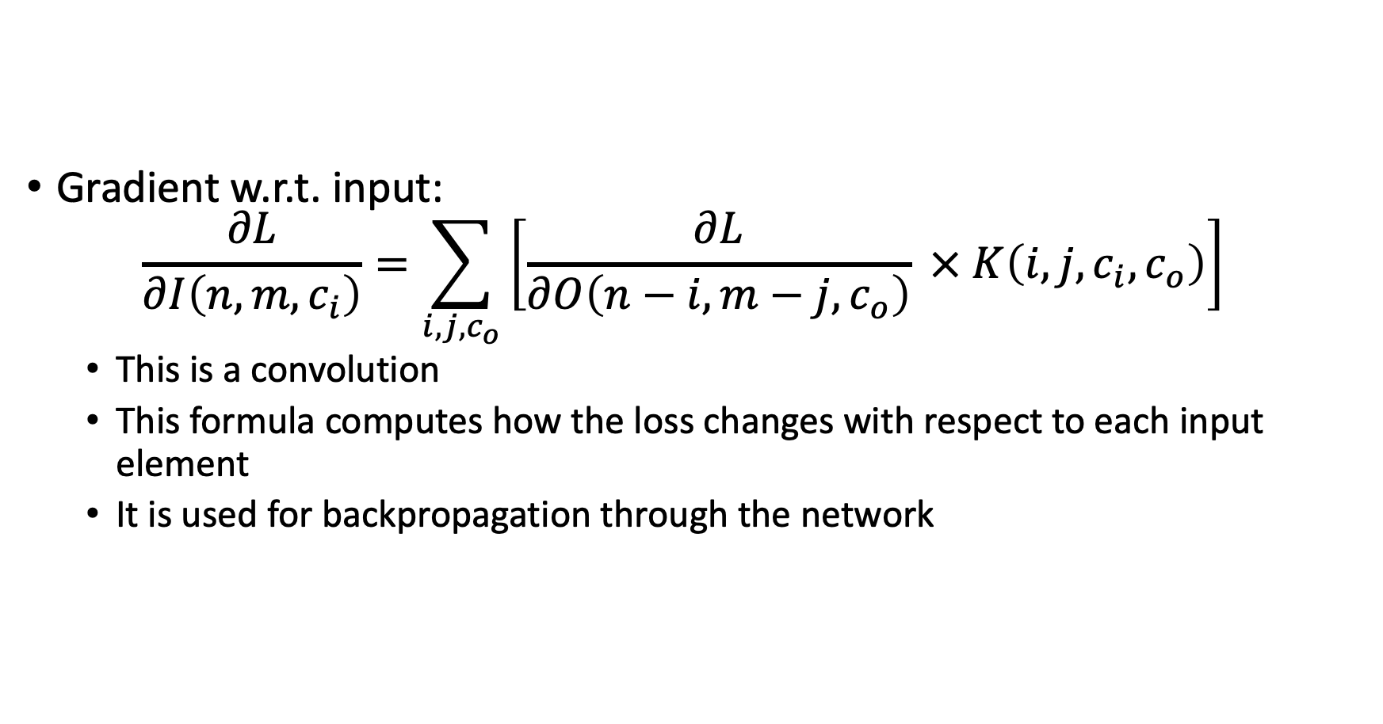
Backward pass of a Convolutional Layer
Gradient w.r.t. input: $\frac{∂L}{∂I\left(n,m,c_{i}\right)}=\sum_{i,j,c_{o}}{\left[\frac{∂L}{∂O\left(n−i,m−j,c_{o}\right)} × K\left(i,j,c_{i},c_{o}\right)\right]}$
This is a convolution
This formula computes how the loss changes with respect to each input element
It is used for backpropagation through the network

Slide 29
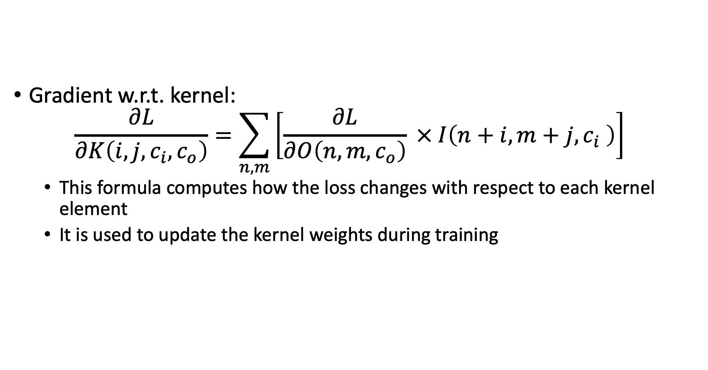
Backward pass of a Convolutional Layer
Gradient w.r.t. kernel: $\frac{∂L}{∂K\left(i,j,c_{i},c_{o}\right)}=\sum_{n,m}{\left[\frac{∂L}{∂O\left(n,m,c_{o}\right)} × I\left(n+i,m+j,c_{i} \right)\right]}$
This formula computes how the loss changes with respect to each kernel element
It is used to update the kernel weights during training

Slide 30
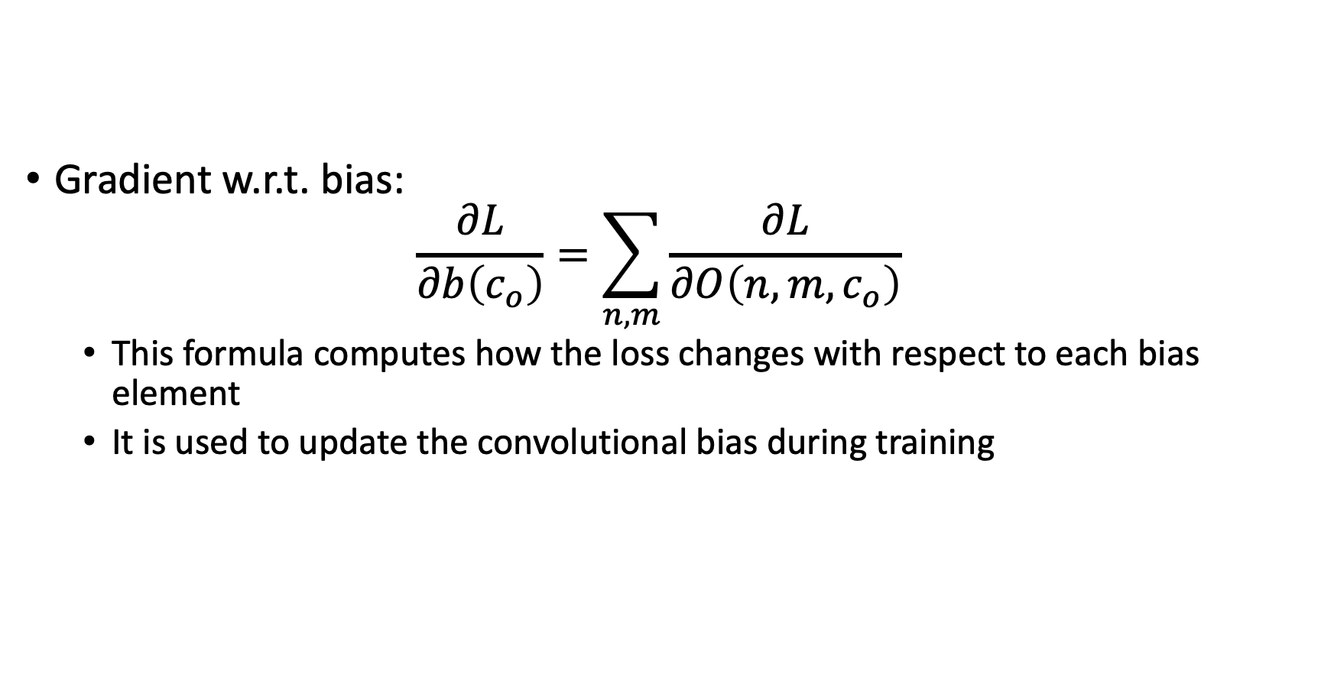
Backward pass of a Convolutional Layer
Gradient w.r.t. bias: $\frac{∂L}{∂b\left(c_{o}\right)}=\sum_{n,m}{\frac{∂L}{∂O\left(n,m,c_{o}\right)}}$
This formula computes how the loss changes with respect to each bias element
It is used to update the convolutional bias during training

Slide 31
Early beginnings of CNNs
Kunihiko Fukushima's Neocognitron (1980)
Hierarchical, multi-layered network
First model with a hierarchical structure similar to the visual cortex
https://www.cs.princeton.edu/courses/archive/spr08/cos598B/Readings/Fukushima1980.pdf
First implementation of convolutional structure
Used local receptive fields and shared weights
Pre-dated modern CNNs by almost two decades
Self-organizing model inspired by visual cortex
Could learn to recognize patterns without explicit supervision
Based on biological principles of visual processing

Slide 32
Early beginnings of CNNs
Yann LeCun's LeNet-5 (1998)
First modern CNN architecture
http://vision.stanford.edu/cs598_spring07/papers/Lecun98.pdf
Handwritten digit recognition (MNIST)
Achieved 0.8% error rate on the MNIST dataset
Used by banks to recognize handwritten digits on checks
Used backpropagation for training
Demonstrated that CNNs could be trained end-to-end
Showed the power of gradient-based learning
Used average pooling for downsampling

Slide 33
Early beginnings of CNNs
What is an average pooling?
Pooling is a common operation in CNNs used to downsample feature maps
Average pooling takes the average value of each sub-region of the input
It is a special case of a convolutional layer with predefined kernel
It reduces the size of the feature map while introducing a form of spatial invariance
Average pooling helps to reduce overfitting and improve generalization
However, it may lose information about the precise location of features
Alternatives to average pooling include max pooling, adaptive pooling
Size of the adaptive pooling is defined by the input and output shapes

Slide 34
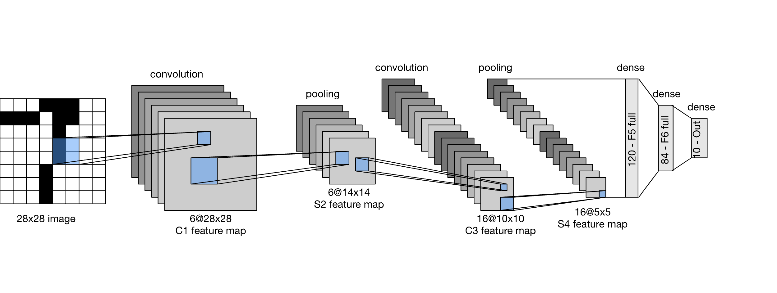
Early beginnings of CNNs
Yann LeCun's LeNet-5 (1998)
By Zhang, Aston and Lipton, Zachary C. and Li, Mu and Smola, Alexander J. - https://github.com/d2l-ai/d2l-en, CC BY-SA 4.0, https://commons.wikimedia.org/w/index.php?curid=152265656

Slide 35
Early beginnings of CNNs
Yann LeCun's LeNet-5 (1998)
Trained and tested on MNIST dataset (60,000 samples)
Short for "Modified National Institute of Standards and Technology database "
MNIST became the "Hello World" of deep learning
"Everything works on MNIST"
https://yann.lecun.org/exdb/mnist/index.html

Slide 36
The CNN Winter and Revival
CNNs faced limited adoption (1990s-2000s)
Computational limitations
Training deep networks required significant computational resources
GPUs were not yet widely used for deep learning
Limited training data
Small datasets like MNIST were insufficient for deep networks
Data augmentation techniques were not yet developed
SVM and other methods dominated CV
Support Vector Machines and other shallow models were more popular
They performed well on small datasets and were easier to train

Slide 37
The CNN Winter and Revival
ImageNet
2006: Fei-Fei Li proposed the creation of ImageNet
"While most people pay attention to models, let's pay attention to data“
July 2008: ImageNet had zero images
December 2008: 3 million images across 6000 synsets
April 2010: 11 million images across 15000 synsets
Today (March 2025): 14.2 million images across 21841 synsets
Made possible through crowdsourcing on Amazon's Mechanical Turk
Provided enough data to train deep networks
https://image-net.org/

Slide 38
The CNN Winter and Revival
ILSVRC (ImageNet Large Scale Visual Recognition Competition)
Organized in 2010 for the first time
Provided an ImageNet large scale subset for training
1.2 million training images across 1,000 categories
Annual competition for image classification (2010-2017)
ILSVRC became the benchmark for computer vision
https://image-net.org/challenges/LSVRC/

Slide 39
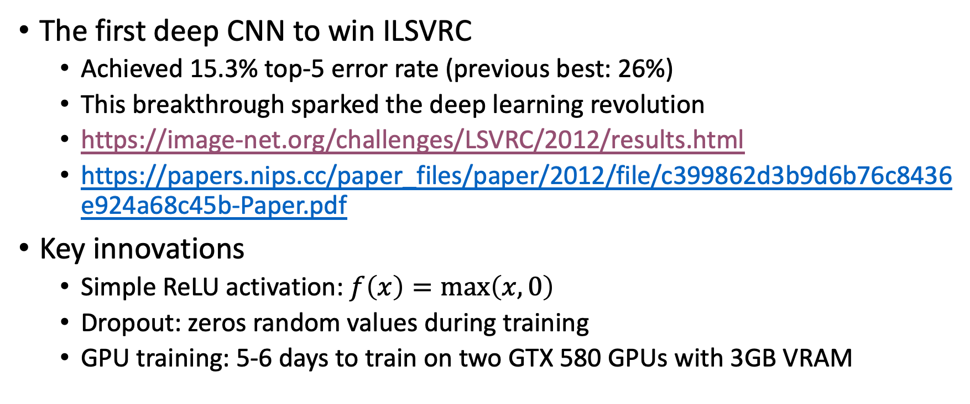
The AlexNet Breakthrough
The first deep CNN to win ILSVRC
Achieved 15.3% top-5 error rate (previous best: 26%)
This breakthrough sparked the deep learning revolution
https://image-net.org/challenges/LSVRC/2012/results.html
https://papers.nips.cc/paper_files/paper/2012/file/c399862d3b9d6b76c8436e924a68c45b-Paper.pdf
Key innovations
Simple ReLU activation: $f\left(x\right)=max\left(x,0\right)$
Dropout: zeros random values during training
GPU training: 5-6 days to train on two GTX 580 GPUs with 3GB VRAM

Slide 40
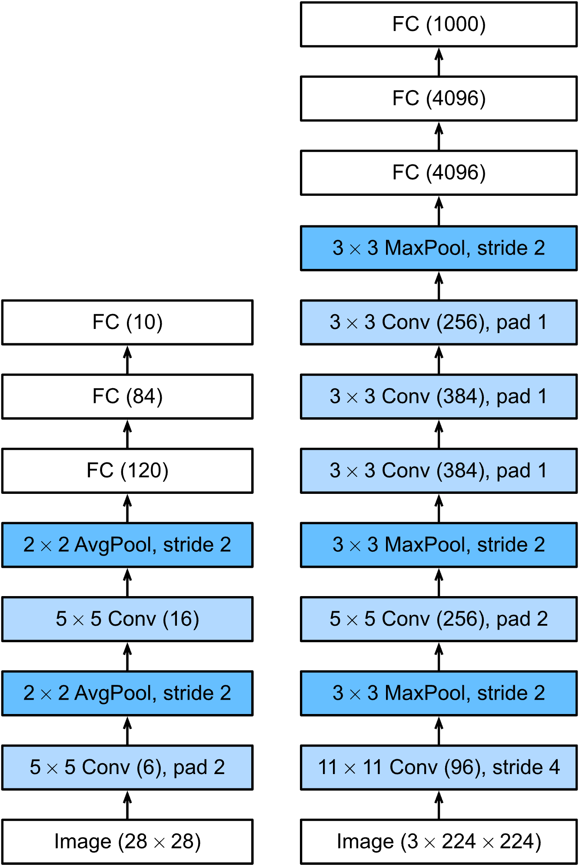
The AlexNet Breakthrough
Architecture limitations
Large convolutional filters in early layers
11×11 and 5×5 filters in early layers
Inefficient compared to smaller filters
Two large MLP layers at the end
6400×4096 and 4096×4096 linear layers
These fully connected layers contain most of the parameters
Inefficient for modern CNN architectures
Total of around 60M parameters
Large number of parameters makes the model computationally expensive
By Zhang, Aston and Lipton, Zachary C. and Li, Mu and Smola, Alexander J. - https://github.com/d2l-ai/d2l-en, CC BY-SA 4.0, https://commons.wikimedia.org/w/index.php?curid=152265712

Slide 41
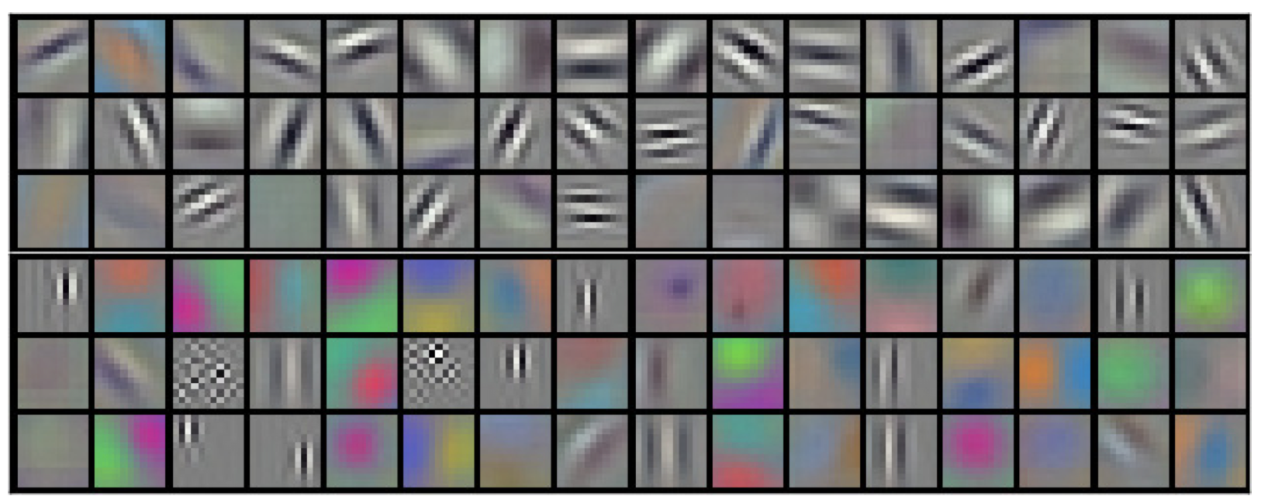
The AlexNet Breakthrough
Visually presented 96 convolutional kernels of size 11x11x3 learned by the first convolutional layer on the 224x224x3 input images
https://papers.nips.cc/paper_files/paper/2012/file/c399862d3b9d6b76c8436e924a68c45b-Paper.pdf

Slide 42
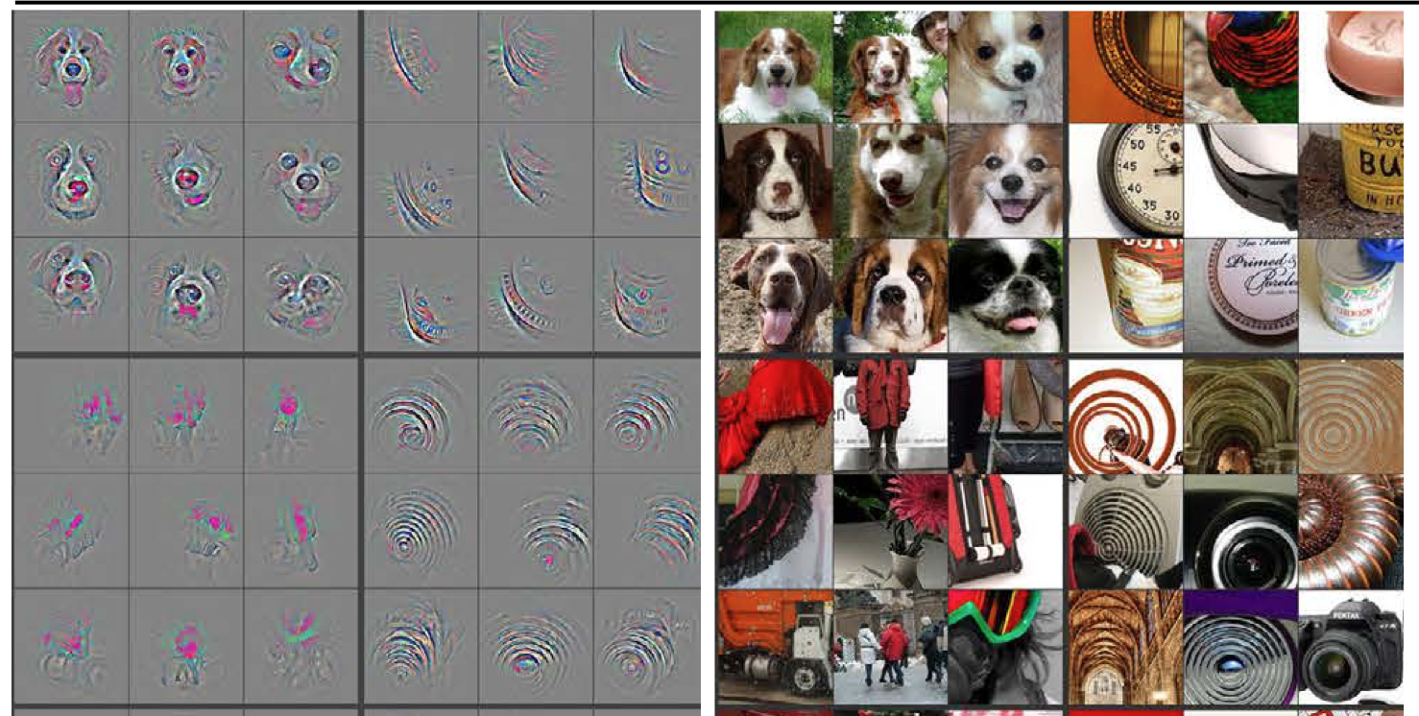
The Deep Learning Revolution
ZFNet (2013): Visualization of CNN layers
Improved AlexNet by adjusting hyperparameters
Developed visualization techniques to understand what CNNs learn
https://arxiv.org/abs/1311.2901

Slide 43
The Deep Learning Revolution
VGGNet (2014): Simplicity and depth (3x3 convolutions)
Won ILSVRC 2014
Key idea: Use multiple 3×3 convolutions between MaxPooling downsampling
Example: two successive 3x3 convolutional layers against a single 5x5 layer
Receptive field is the same and output feature maps are of the same shape
Two 3x3 layers require 18 parameters
Single 5x5 layer requires 25 parameters
Showed that deep and narrow convolutions outperform wider counterparts
Replaces larger filters with stacks of 3×3 filters
3 x 3 convolutions became de-facto standard.
https://arxiv.org/abs/1409.1556

Slide 44
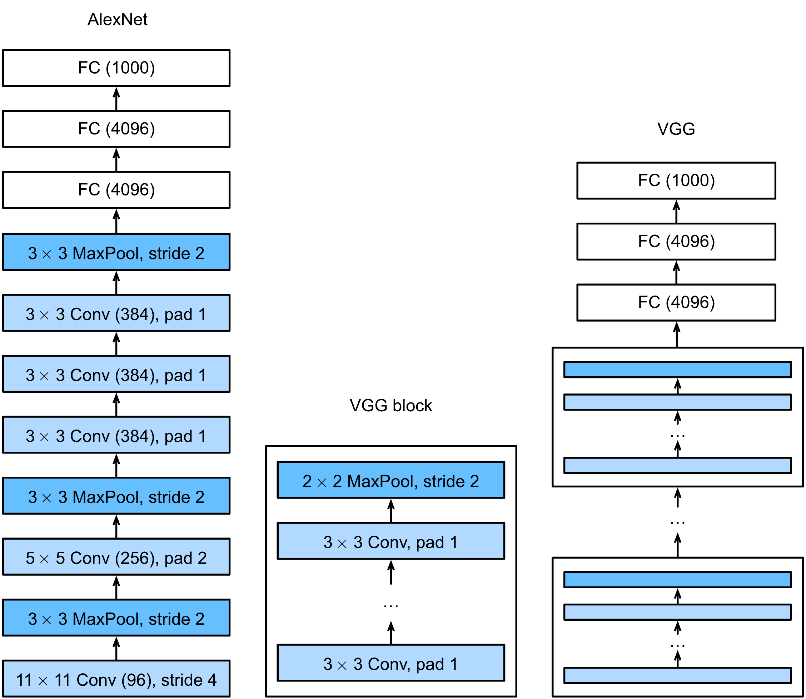
The Deep Learning Revolution
VGGNet (2014)
VGG networks trained on ImageNet are excellent feature extractors.
VGG-11: 8 convolutional and 3 fully-connected layers
VGG-16: 13 convolutional and 3 fully-connected layers
VGG-19: 16 convolutional and 3 fully-connected layers
By Zhang, Aston and Lipton, Zachary C. and Li, Mu and Smola, Alexander J. - https://github.com/d2l-ai/d2l-en, CC BY-SA 4.0, https://commons.wikimedia.org/w/index.php?curid=152265699

Slide 45
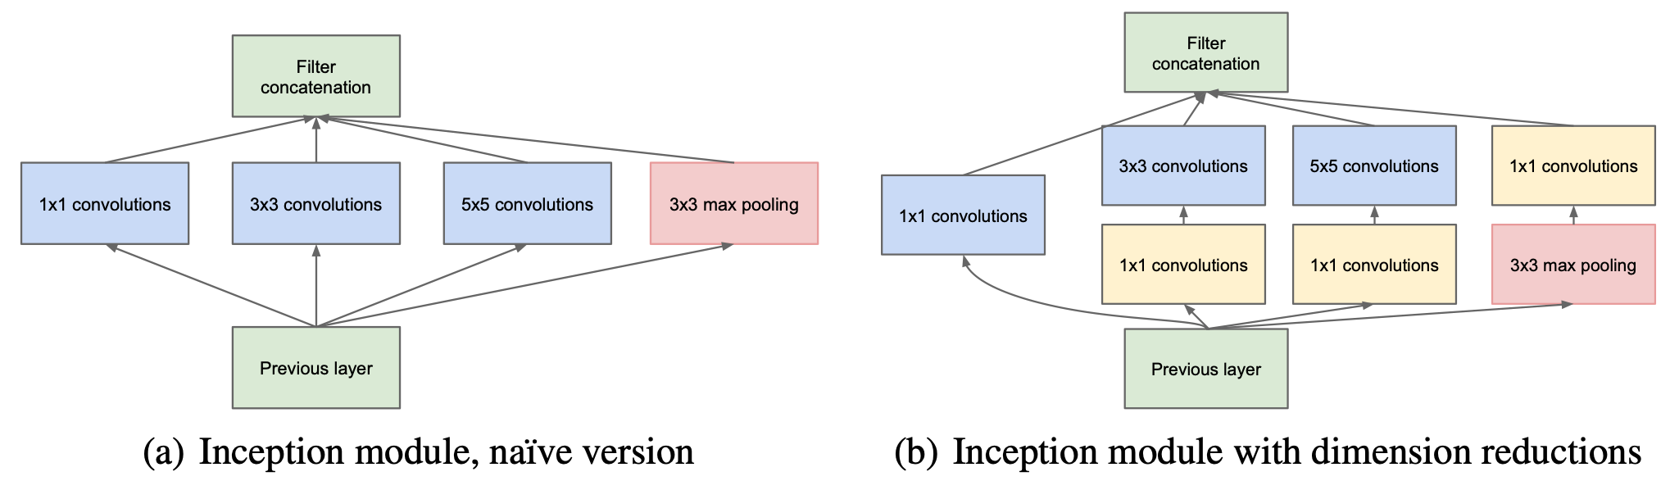
The Deep Learning Revolution
GoogLeNet/Inception (2014): Inception modules
Won ILSVRC 2014
Multi-branch networks
Parallel paths with different filter sizes
https://arxiv.org/abs/1409.4842
https://arxiv.org/abs/1409.4842

Slide 46
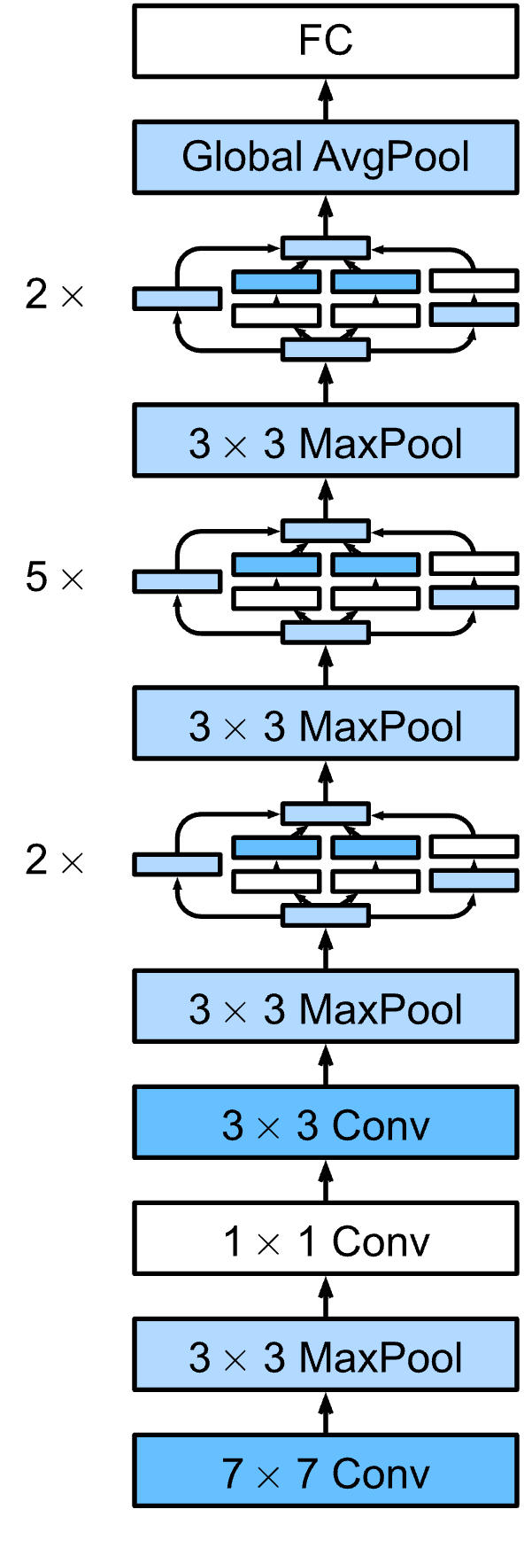
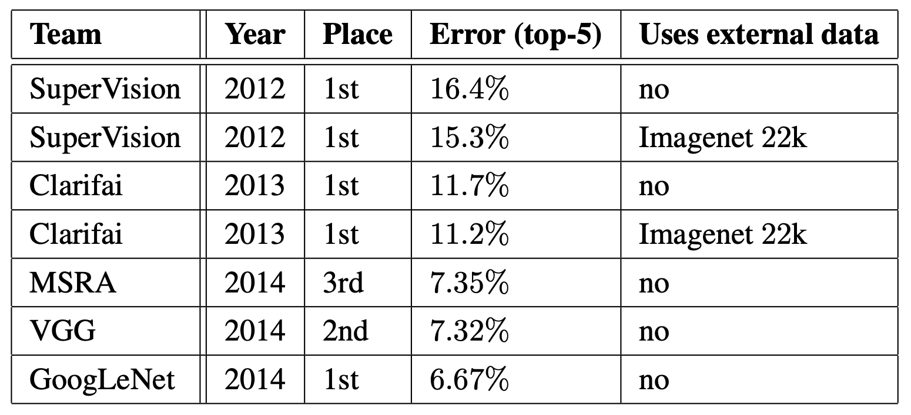
The Deep Learning Revolution
GoogLeNet/Inception (2014)
First few layers: feature extracting stem
Last layer: classification head
Everything in between: body
https://arxiv.org/pdf/1409.4842
By Zhang, Aston and Lipton, Zachary C. and Li, Mu and Smola, Alexander J. - https://github.com/d2l-ai/d2l-en, CC BY-SA 4.0, https://commons.wikimedia.org/w/index.php?curid=152265655

Slide 47
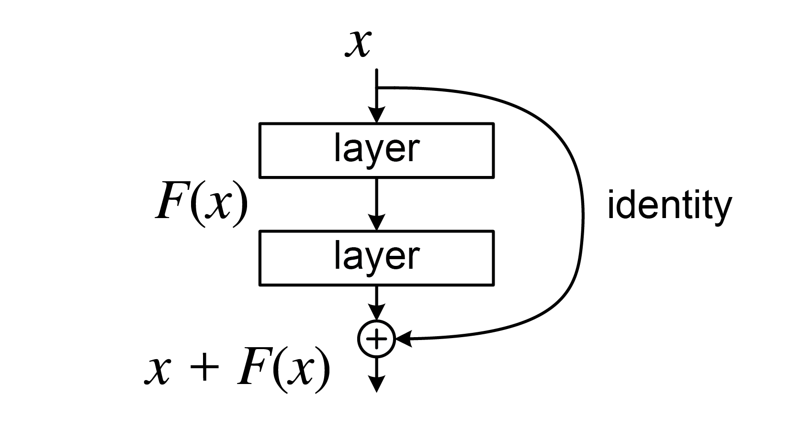
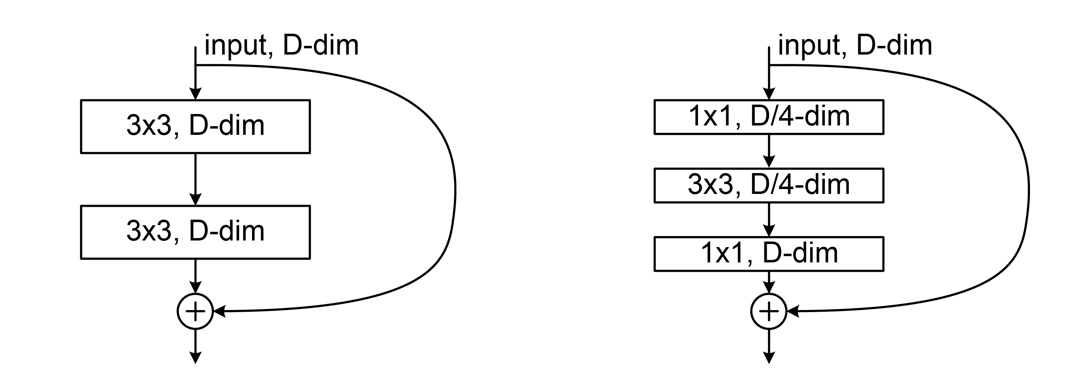
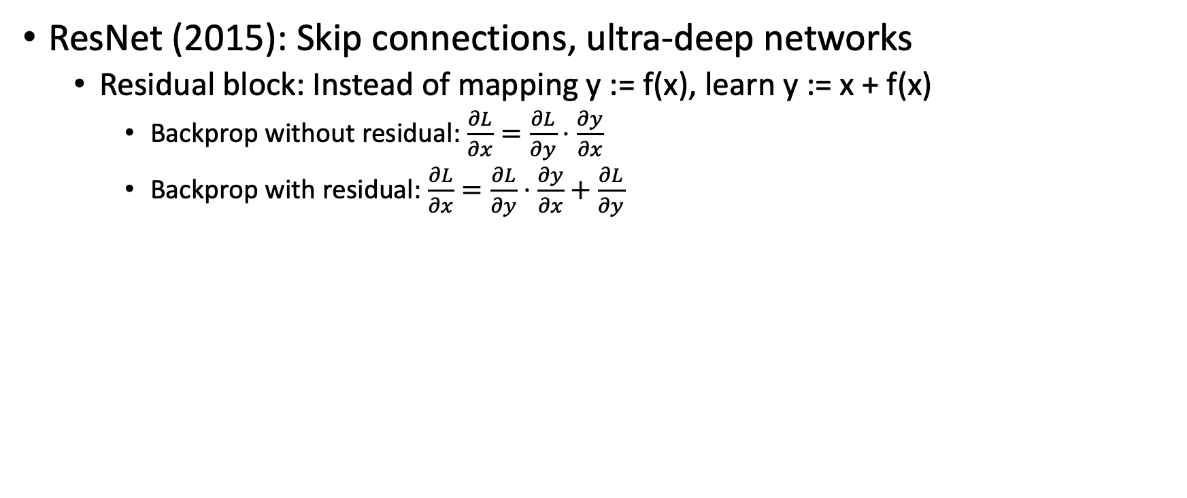
The Deep Learning Revolution
ResNet (2015): Skip connections, ultra-deep networks
Residual block: Instead of mapping y := f(x), learn y := x + f(x)
Backprop without residual: $\frac{∂L}{∂x}=\frac{∂L}{∂y}⋅\frac{∂y}{∂x}$
Backprop with residual: $\frac{∂L}{∂x}=\frac{∂L}{∂y}⋅\frac{∂y}{∂x}+\frac{∂L}{∂y}$
By LunarLullaby - Own work, CC BY-SA 4.0, https://commons.wikimedia.org/w/index.php?curid=131458370
By LunarLullaby - Own work, CC BY-SA 4.0, https://commons.wikimedia.org/w/index.php?curid=131466161

Slide 48
The Deep Learning Revolution
ResNet (2015): Skip connections, ultra-deep networks
Residual block: Instead of mapping y := f(x), learn y := x + f(x)
Allows the network to learn residual functions
Allows training of very deep networks
ResNet-152 has 152 layers (vs. 19 in VGG-19)
Learn correction to previous features
Each block learns to correct the input rather than transform it completely
Family of models: ResNet-18, ResNet-34, ResNet-50, ResNet-101
Different depths for different computational budgets
https://arxiv.org/abs/1512.03385
https://arxiv.org/abs/1603.05027

Slide 49
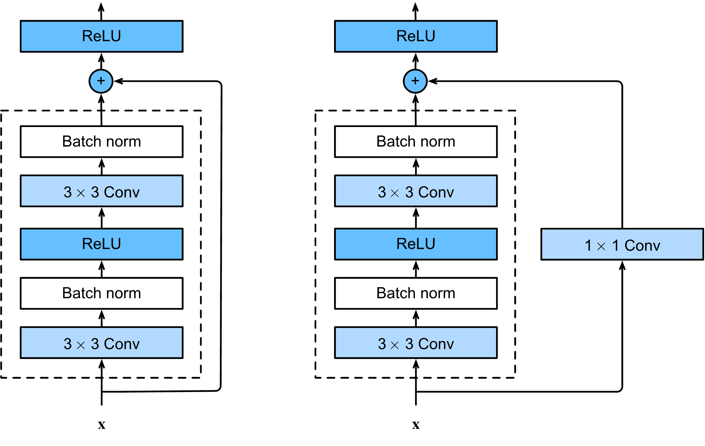
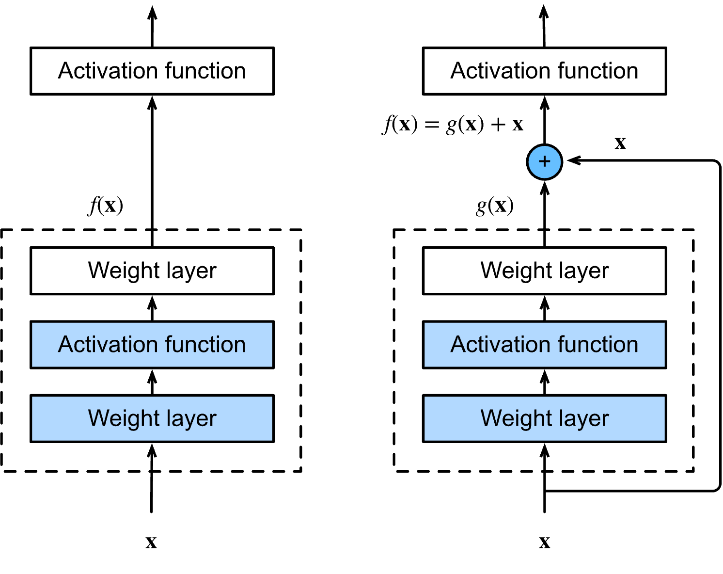
The Deep Learning Revolution
ResNet (2015): Skip connections, ultra-deep networks
https://d2l.ai/chapter_convolutional-modern/resnet.html
https://d2l.ai/chapter_convolutional-modern/resnet.html

Slide 50
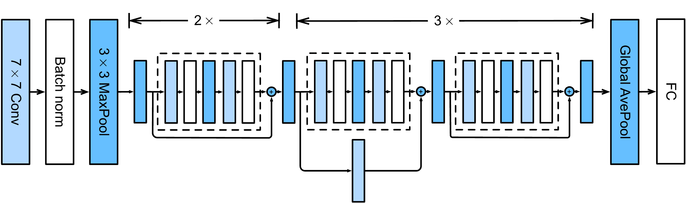
The Deep Learning Revolution
ResNet (2015): ResNet-18
https://d2l.ai/chapter_convolutional-modern/resnet.html

Slide 51
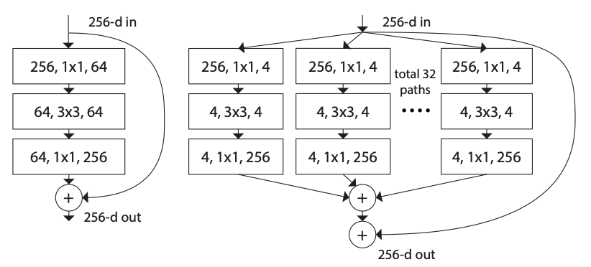
The Deep Learning Revolution
Variants of ResNet
ResNext: Information flows through several groups then aggregated
Combines ResNet with grouped convolutions (like inception block in GoogLeNet)
https://arxiv.org/abs/1611.05431
https://arxiv.org/abs/1611.05431

Slide 52
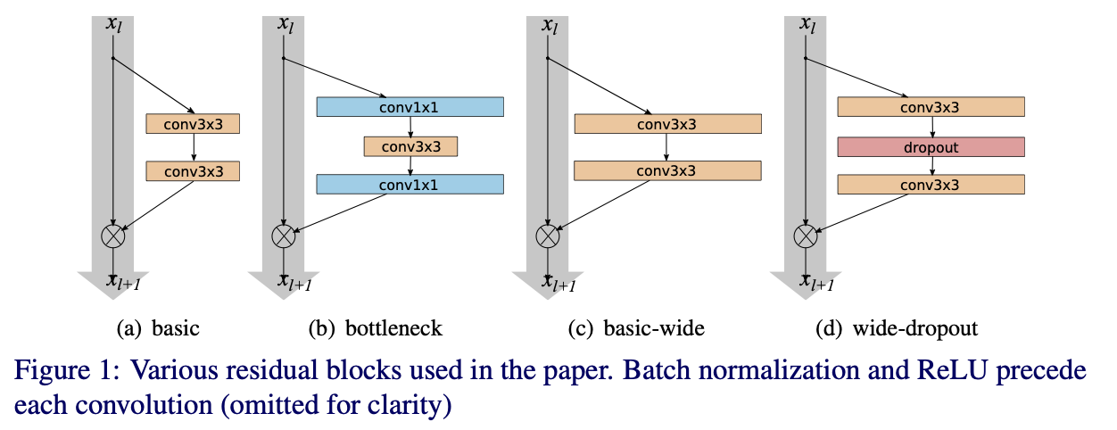
The Deep Learning Revolution
Variants of ResNet
WideResNet: Wider blocks shown to be superior
Increases width instead of depth
https://arxiv.org/abs/1605.07146
https://arxiv.org/abs/1605.07146

Slide 53
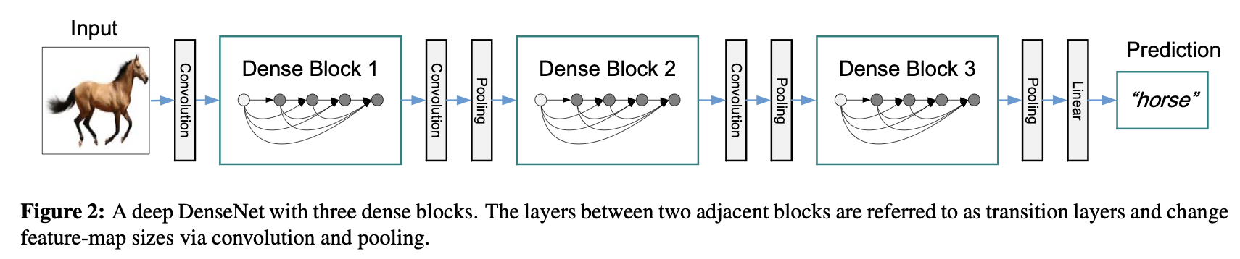
The Deep Learning Revolution
DenseNet (2017): Dense connections between layers
Each layer is connected to all preceding layers
Improves gradient flow and feature reuse
https://arxiv.org/abs/1608.06993
https://arxiv.org/abs/1608.06993

Slide 54
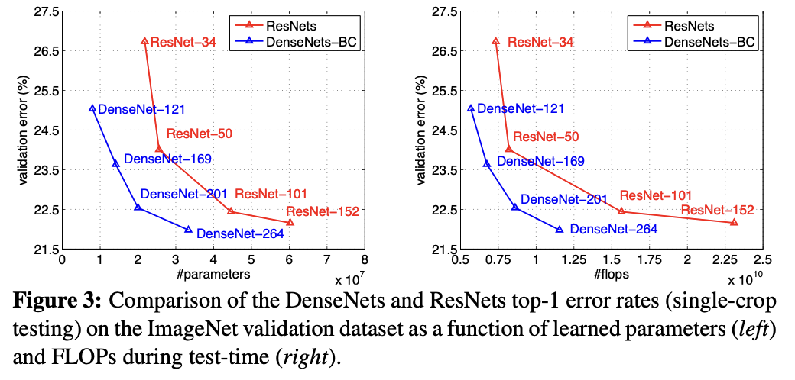
The Deep Learning Revolution
DenseNet (2017): Dense connections between layers
https://arxiv.org/abs/1608.06993

Slide 55
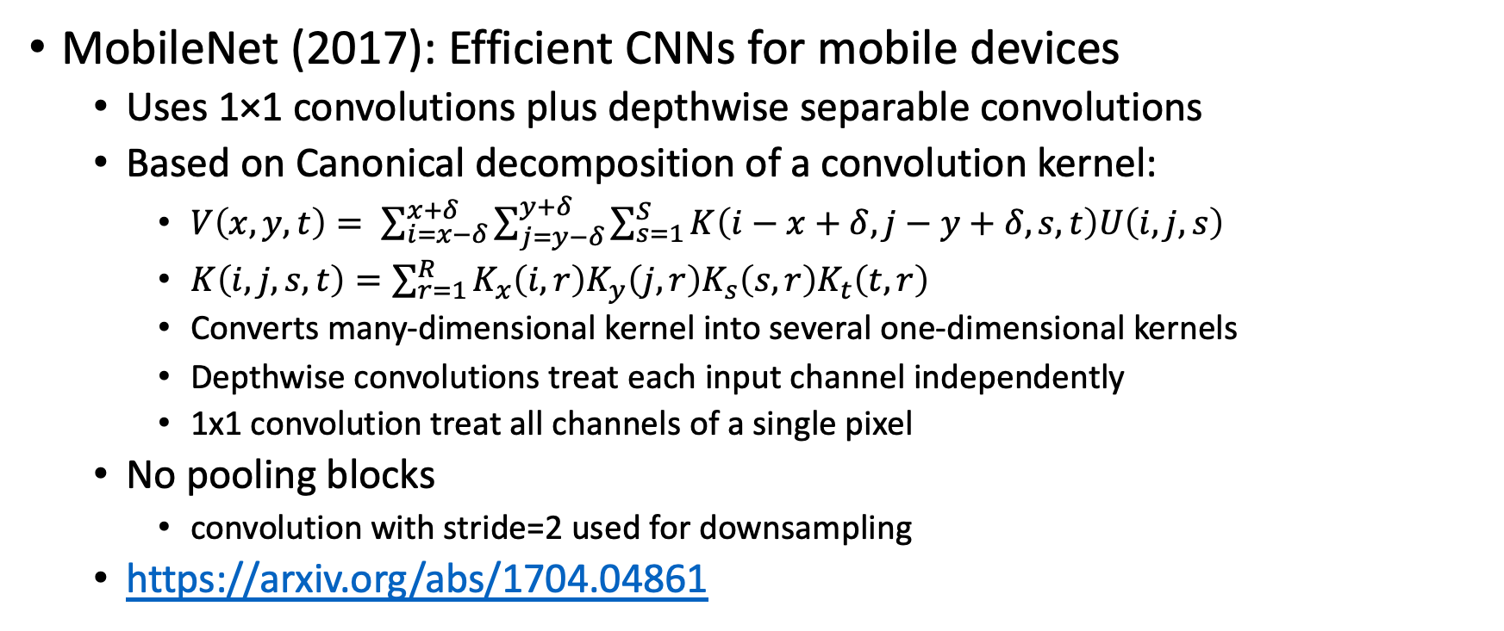
The Deep Learning Revolution
MobileNet (2017): Efficient CNNs for mobile devices
Uses 1×1 convolutions plus depthwise separable convolutions
Based on Canonical decomposition of a convolution kernel:
$V\left(x, y, t\right)= \sum_{i=x−δ}^{x+δ}{\sum_{j=y−δ}^{y+δ}{\sum_{s=1}^{S}{K\left(i−x+δ, j−y+δ, s, t\right)U\left(i, j, s\right)}}}$
$K\left(i,j,s,t\right)=\sum_{r=1}^{R}{K_{x}\left(i,r\right)K_{y}\left(j,r\right)K_{s}\left(s,r\right)K_{t}\left(t,r\right)}$
Converts many-dimensional kernel into several one-dimensional kernels
Depthwise convolutions treat each input channel independently
1x1 convolution treat all channels of a single pixel
No pooling blocks
convolution with stride=2 used for downsampling
https://arxiv.org/abs/1704.04861

Slide 56
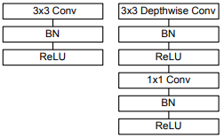
The Deep Learning Revolution
MobileNet (2017): Efficient CNNs for mobile devices
Uses 1×1 convolutions plus depthwise separable convolutions
Based on Canonical decomposition of a convolution kernel:
No pooling blocks
https://arxiv.org/abs/1704.04861
https://raw.githubusercontent.com/oseledets/dl2024/8d739d06892c9cc71f198c1c478d51b4a6801866/lectures/lecture-2/mobilenet-block.png

Slide 57
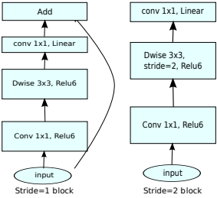
The Deep Learning Revolution
MobileNetV2 (2018): Inverted bottleneck design
First 1×1 convolution increases channels, last decreases
Expands channels in the middle of the block
Some blocks have residual connections, others do not
Combines ideas from ResNet and MobileNet
https://arxiv.org/abs/1801.04381
https://raw.githubusercontent.com/oseledets/dl2024/8d739d06892c9cc71f198c1c478d51b4a6801866/lectures/lecture-2/mobilenetV2.png

Slide 58
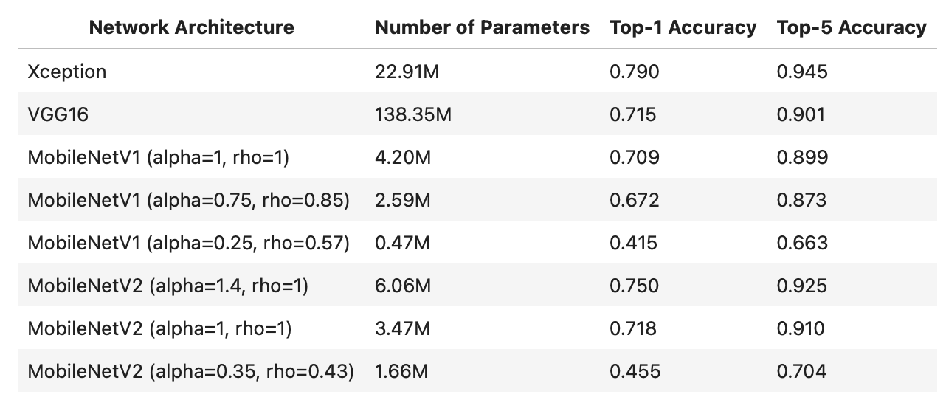
The Deep Learning Revolution
https://github.com/oseledets/dl2024/blob/main/lectures/lecture-2/lecture-2.ipynb

Slide 59
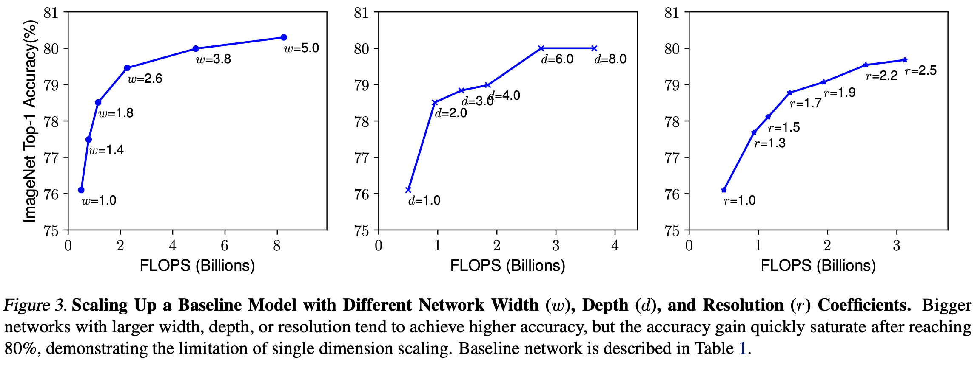
The Deep Learning Revolution
EfficientNet (2019): Balanced scaling of network dimensions
All CNNs are similar and contain several stages
Scaling only a single parameter quickly saturates after 80% accuracy
https://arxiv.org/abs/1905.11946

Slide 60
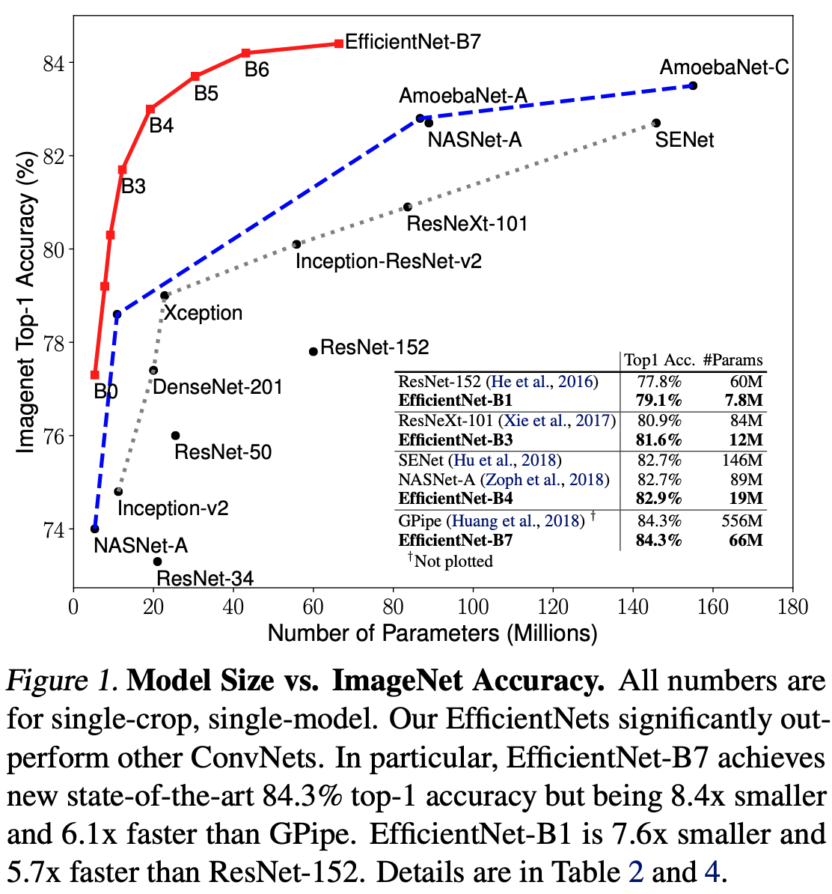
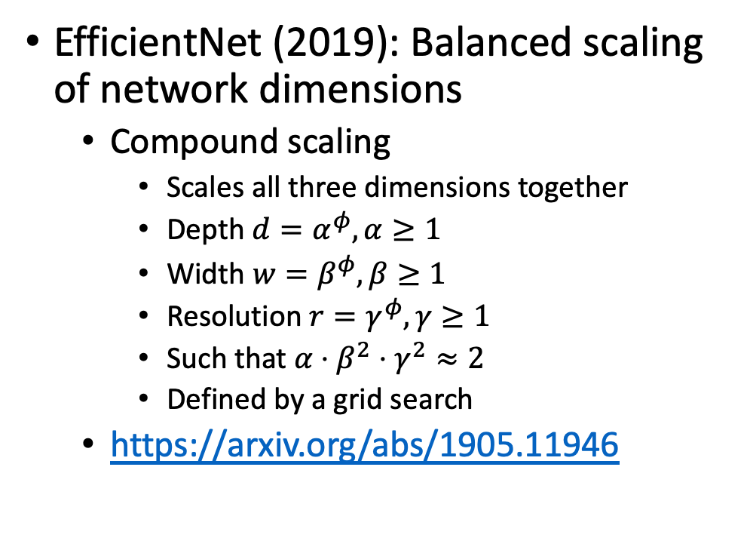
The Deep Learning Revolution
EfficientNet (2019): Balanced scaling of network dimensions
Compound scaling
Scales all three dimensions together
Depth $d=α^{φ}, α≥1$
Width $w=β^{φ}, β≥1$
Resolution $r=γ^{φ}, γ≥1$
Such that $α⋅β^{2}⋅γ^{2}≈2$
Defined by a grid search
https://arxiv.org/abs/1905.11946
https://arxiv.org/abs/1905.11946

Slide 61
Transformers
Vision Transformers (2020): Incorporating transformer architecture
Treats images as sequences of patches
Uses self-attention instead of convolutions
Outperforms CNNs for many tasks
https://arxiv.org/abs/2010.11929

